Slide 1
Warm-Up
Why did hunters and gatherers possibly begin farming?
What cause more villages to be established?
List some metals that you use in your daily life

Slide 2
Metallurgy
6.3

Slide 3
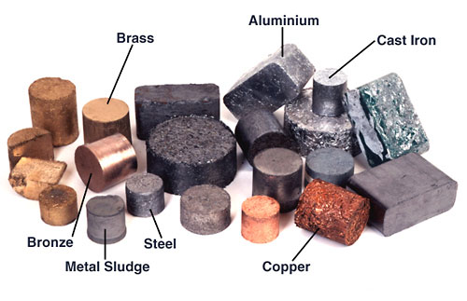
Metallurgy- The scientific study and technology of extracting metals from ores, refining them for use, and creating alloys and useful objects from them.

Slide 4
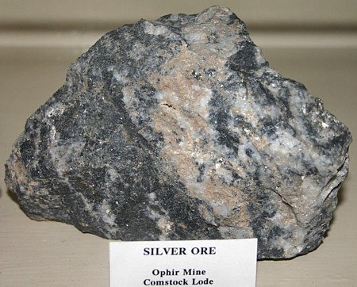
Ores
a naturally occurring solid material from which a metal or valuable mineral can be profitably extracted.

Slide 5
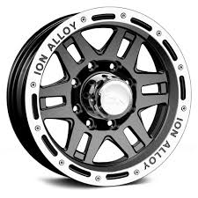
Alloy
a metal made by combining two or more metallic elements, especially to give greater strength or resistance to corrosion.

Slide 6
