Slide 1
Ancient Chinese Dynasties

Slide 2
Chinese Dynasties
Xia (2000 - 1650 BC)
Shang (1650 - 1027 BC)
Zhou (1027 - 256 BC)
Qin (221 - 110 BC)
Han (206 BC – 220 AD)
Age of Disunity (220 AD – 589 AD)
Sui (589 – 618 AD)
Tang (618 – 907 AD)
Song (960 – 1279 AD)
Mongol (Yuan) (1215 – 1368 AD)
Ming (1368 – 1644 AD)
Manchu (Qing) (1644 – 1912 AD)

Slide 3
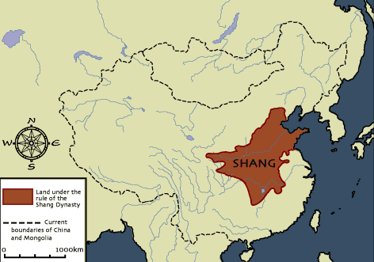
Shang Dynasty
First recorded Chinese dynasty.
Began along the Huang He River. They did not fortify their cities.

Slide 4
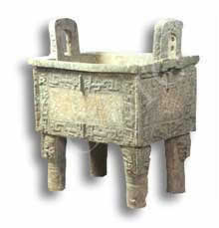
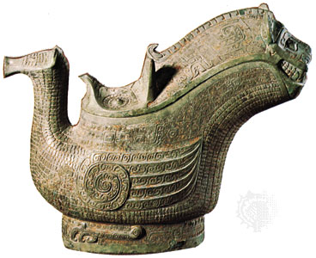
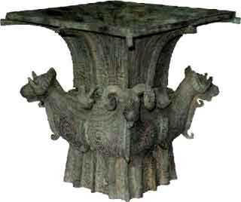
Ruled by a king and wealthy nobles.
Excelled in bronze work.
Made silk cloth.
Worshipped their ancestors and local gods.

Slide 5
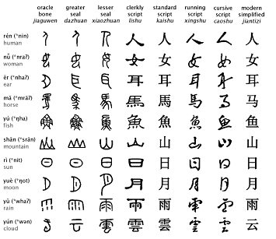
Developed a basic system of writing.

Slide 6
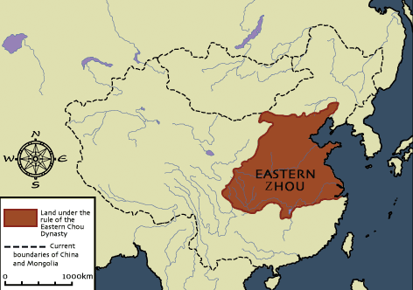
The Zhou Dynasty
Defeated the Shang.

Slide 7
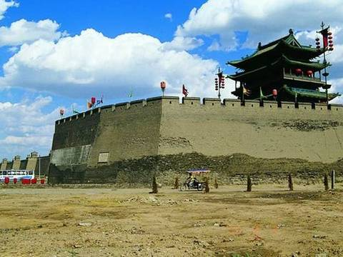
Divided their territories into walled cities.
Practiced feudal system (Peasants working the land for lords / nobility)
Rulers called selves, “The Sons of Heaven”
Taoism, Confucianism, and Legalism began.

Slide 8
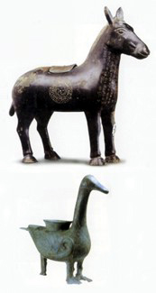
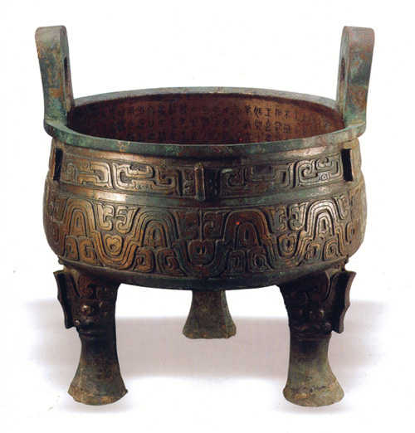
The Zhou Dynasty
Iron used to make tools and other items.

Slide 9
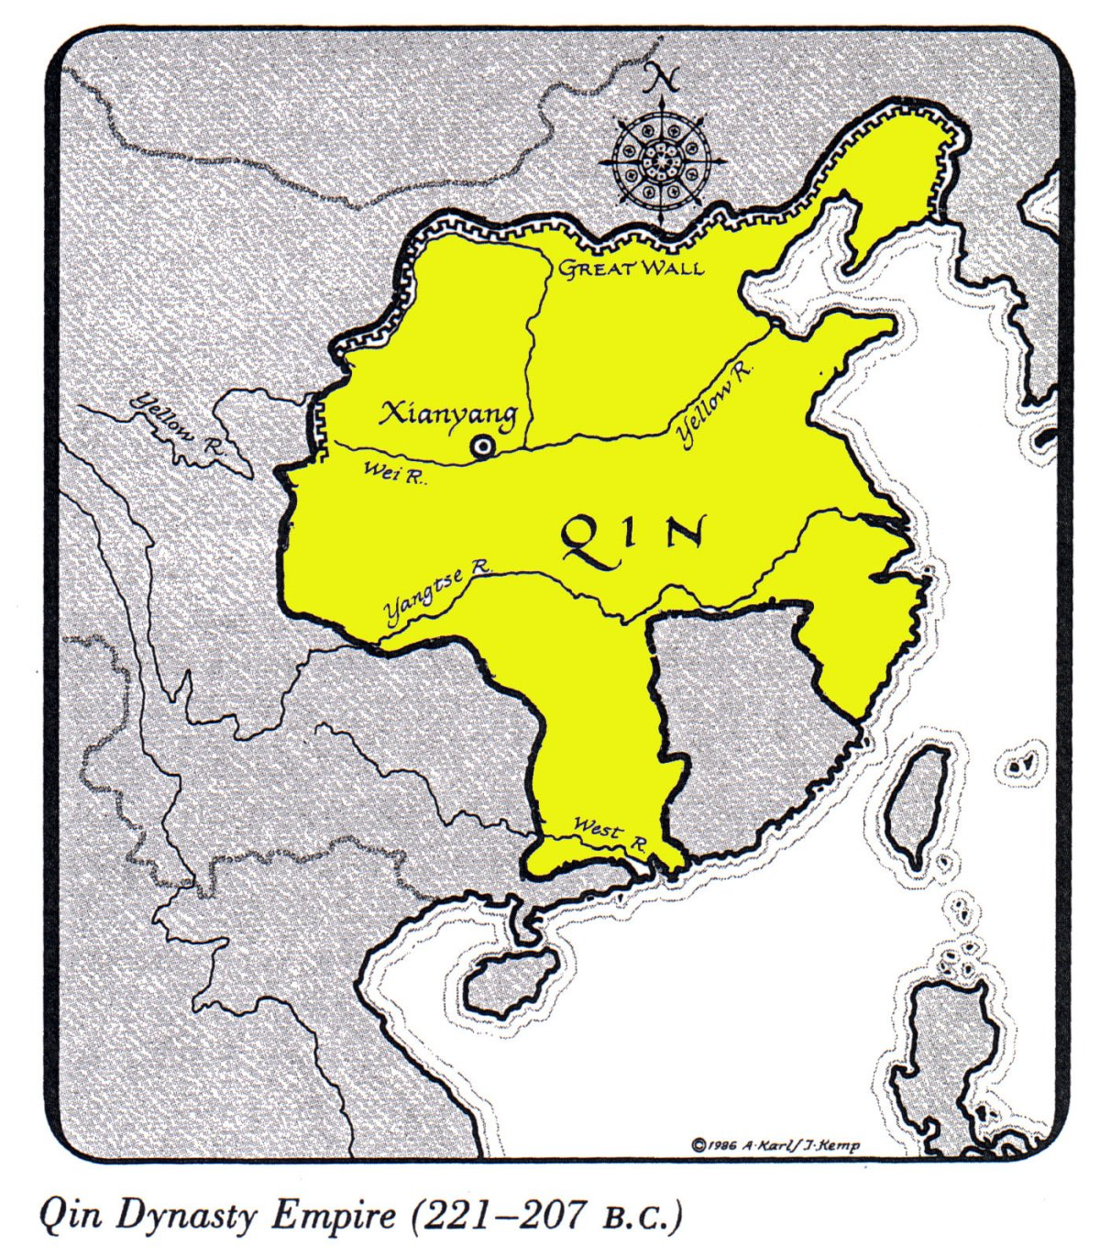
The Qin Dynasty
The First Emperor of China, Qin Shi Huangdi united China under the Qin Dynasty - ruled China from 221 - 210 B.C.

Slide 10
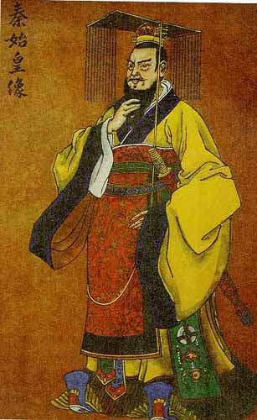
CHINA UNDER Qin Shi Huangdi
Qin Shi Huangdi built a strong authoritarian government - divided China into 36 military districts.
A brutal leader - jailed, tortured and killed those who opposed his rule.

Slide 11
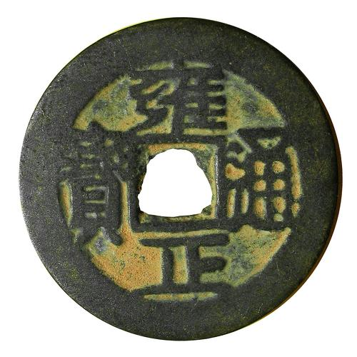
He standardized weights and measures, created a standard currency.
Improved roads and canals to strengthen the transportation system within China.
He began a campaign to burn books by Confucian scholars. Only books on medicine and agriculture were spared.

Slide 12
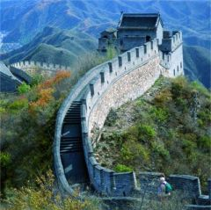
He ordered that the individual walls of the former feudal states be joined, thus creating the Great Wall of China. This showed the emperor’s ability to mobilize vast resources!

Slide 13
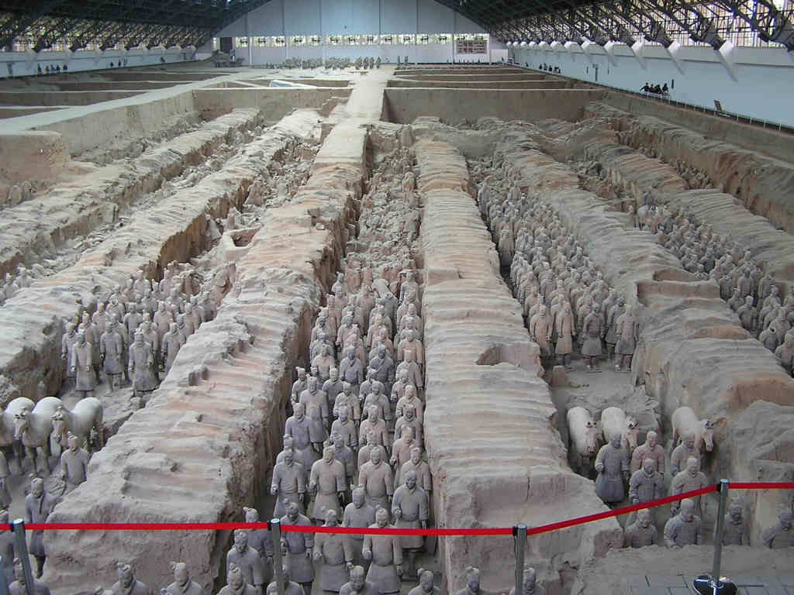
After his death in 210 B.C. anger over cruel policies, heavy taxes and forced labor erupted into revolts!
Interesting Fact: More than 8,000 terra cotta soldiers stand guard inside the tomb of Shi Huangdi.

Slide 14
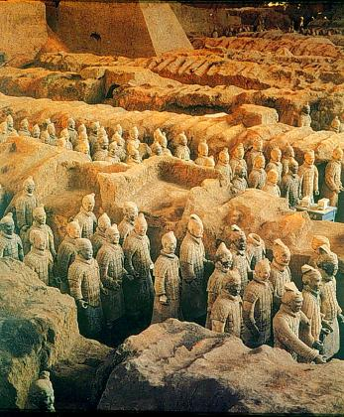
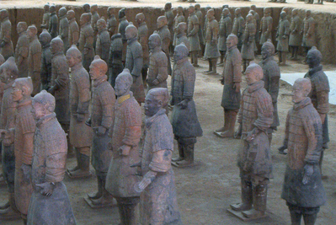
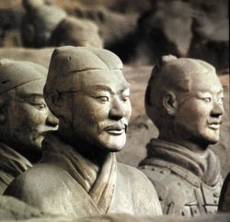

Slide 15
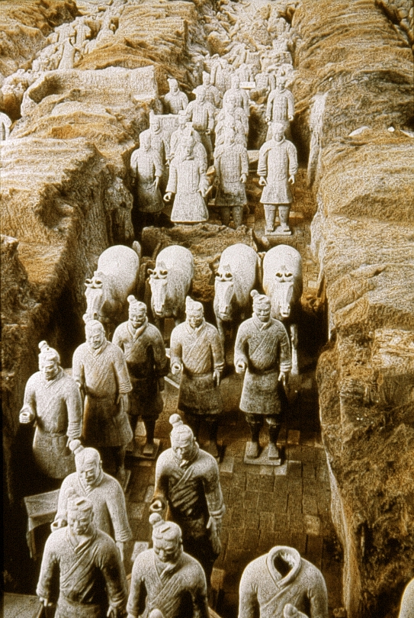
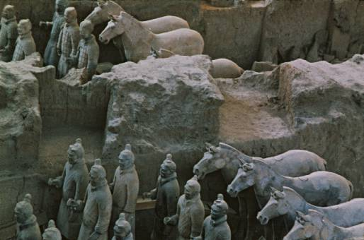
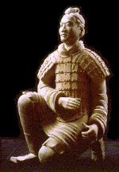

Slide 16
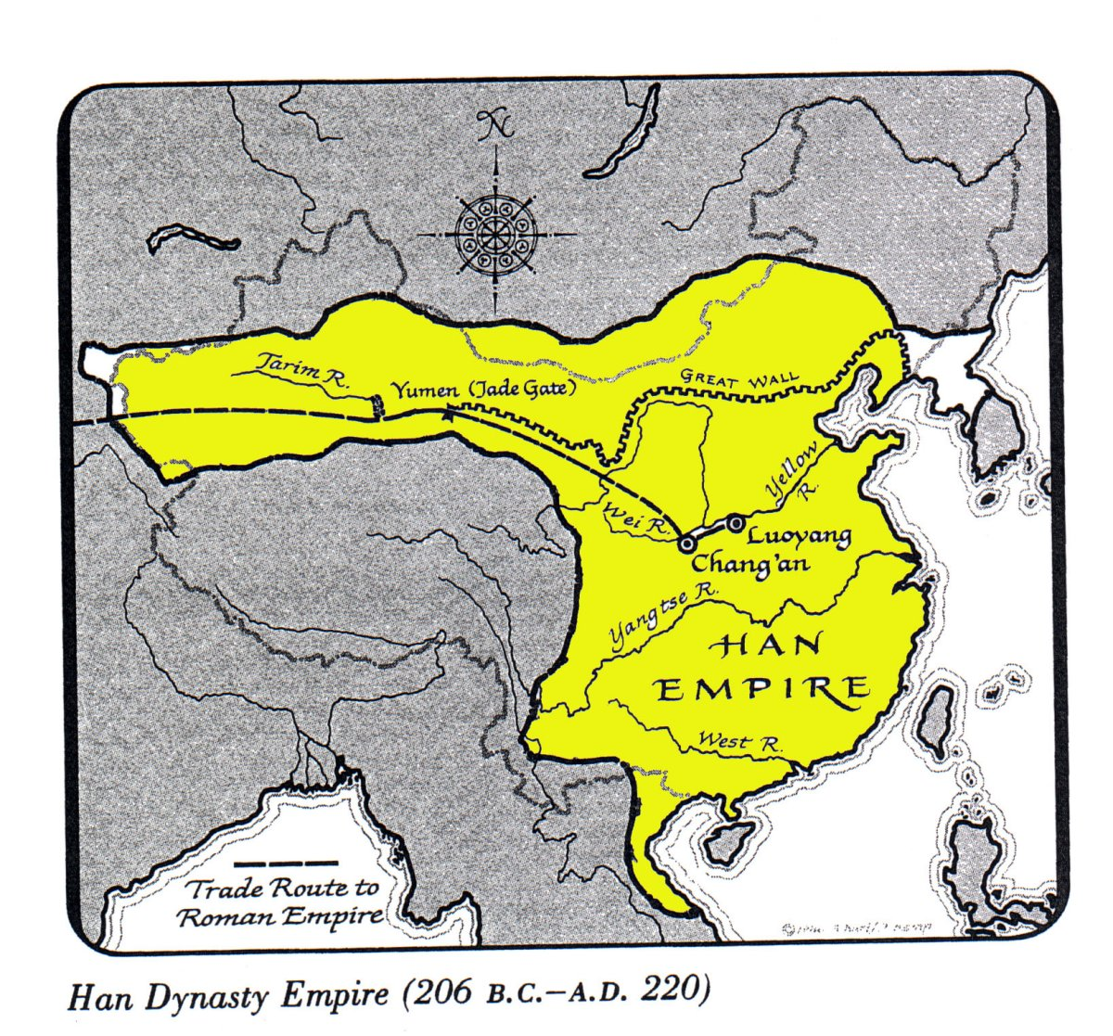
The Han Dynasty
China’s “Golden Age”

Slide 17
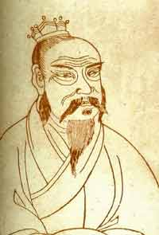
Liu Bang
First Emperor under Han Dynasty – also known as Gaozu.
Liu was an illiterate peasant leader who defeated rival armies.
Liu, like earlier Chinese rulers, claimed The Mandate of Heaven.

Slide 18
He continued earlier efforts to unify China, but his main focus was on lowering taxes and easing the Qin emperor’s harsh legalist policies.
He returned Confucian scholars to roles within the government.

Slide 19
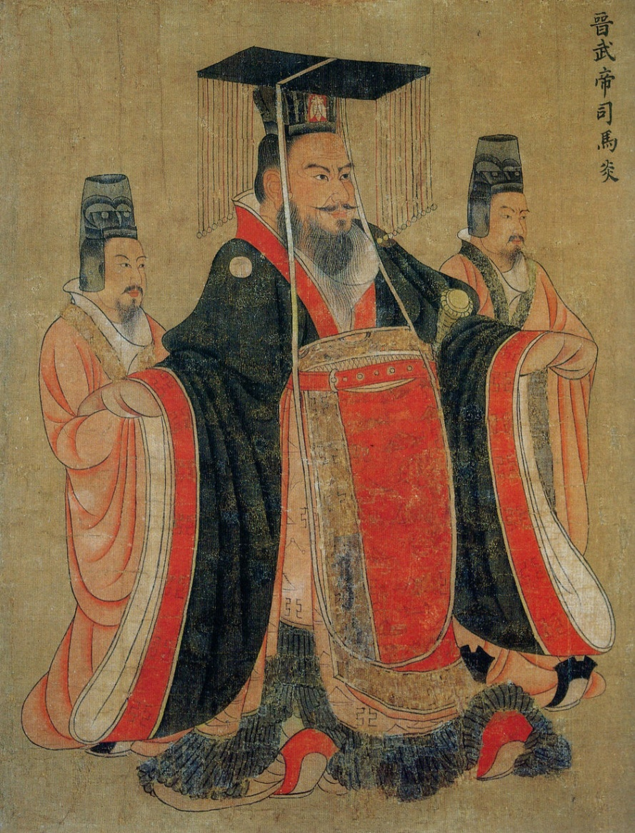
Emperor Wudi
Most famous Han Emperor - strengthened the economy and government of China.
He chose Confucian officials to help run his government.

Slide 20
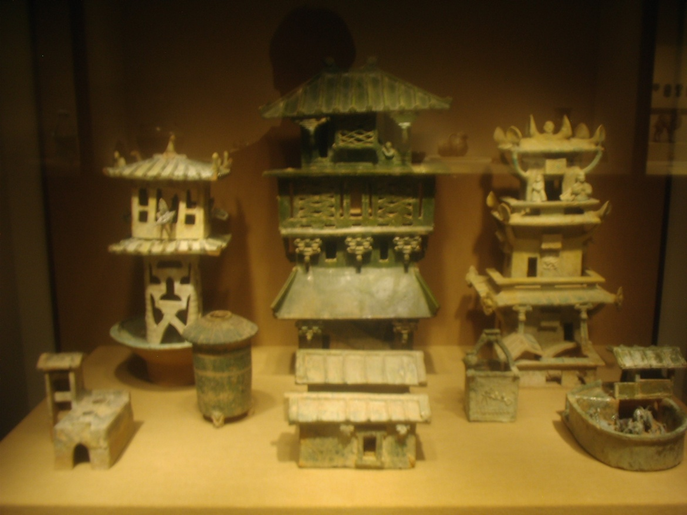
To train scholars, he set up an imperial university at Xian.
He set up granaries around the empire so that the government could buy grain when it was abundant and sell it at stable prices when it was scarce.

Slide 21
Organized a government monopoly on salt and iron - this gave the government a source of income other than taxing the peasants!
Wudi earned the title, “The Warrior Emperor,” because of his endless campaigns to secure and expand China’s borders.
Wudi opened up a route to build alliances among the nomadic rulers, which later became known as the Silk Road

Slide 22
Han Society
Han emperors made Confucianism the official belief system of the state.
They relied on well-educated scholars to run the bureaucracy.
These scholar-officials were expected to match the Confucian ideal of a gentleman.

Slide 23
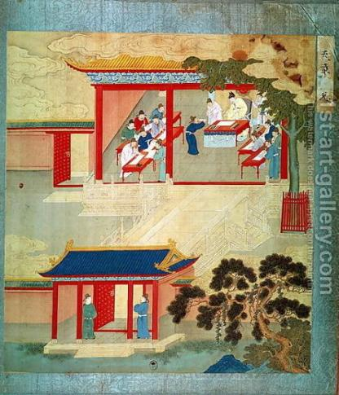
The Han government felt that individuals should be chosen based on merit rather than on family position. To find the most qualified people, the Han government set up Civil Service examinations. A person must study the Confucian classics, a collection of histories, poems, and handbooks on customs in order to pass the exams.

Slide 24
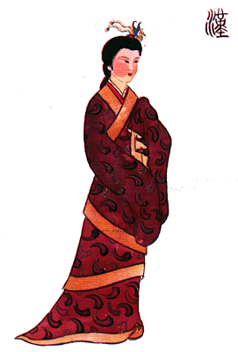
Because women were viewed as inferior to men, they were not allowed to take the Civil service examinations few and received an education.
Women were expected to be modest and yield to men.

Slide 25
Han Achievements
During its time, Han China was the most technologically advanced civilization in the entire world.
Han scientists wrote texts on chemistry, zoology, botany and other subjects.

Slide 26
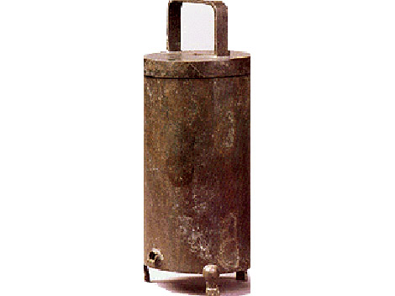
Han astronomers observed and measured the movements of the stars and planets, which allowed them to improve earlier calendars and invent better timekeeping devices.

Slide 27
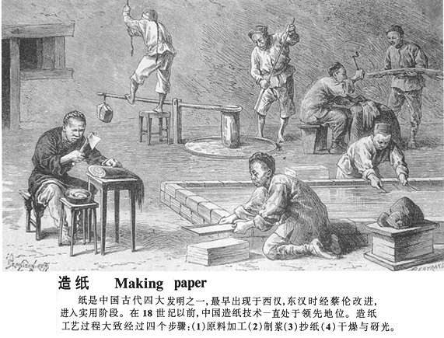
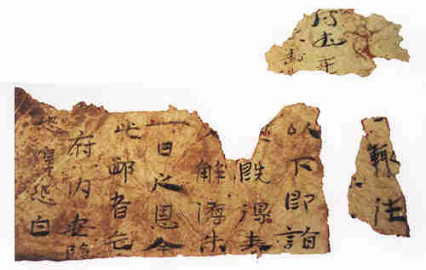
Cai Lun, an official in the Han court, invented a method for making durable paper out of wood pulp. His basic method is still used to manufacture paper today.

Slide 28
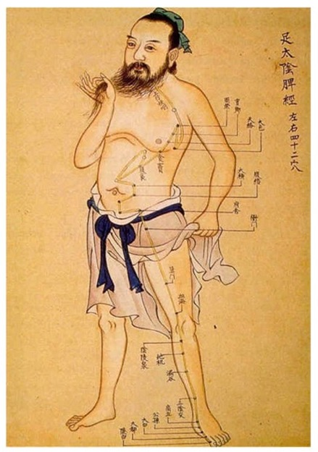
Han Medical Advances
Chinese Physicians diagnosed diseases and developed anesthetics
Experimented with herbal remedies and other drugs
Some doctors explored uses of acupuncture

Slide 29
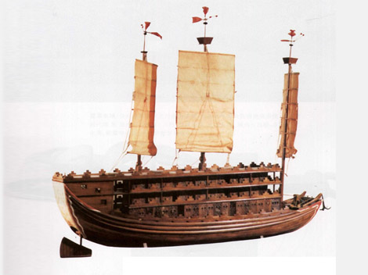
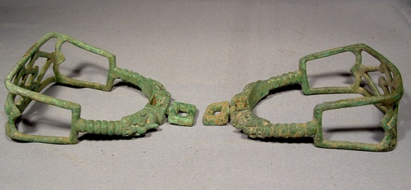
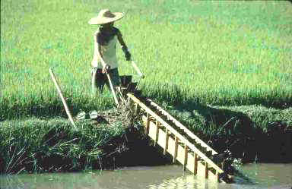
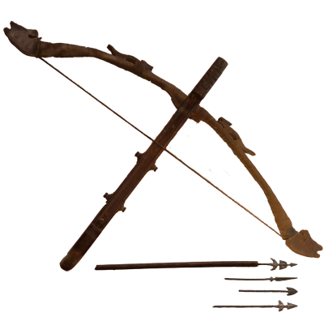
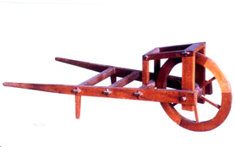
Other Han Achievements
Advanced methods of Shipbuilding
Invention of the rudder
Iron Stirrups
Crossbows
Wheel Barrows
Suspension Bridges
Chain Pumps

Slide 30
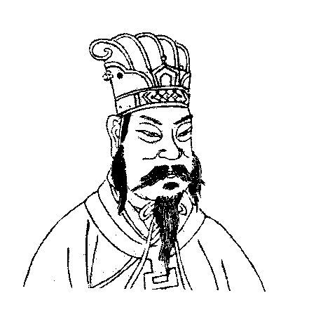
Han China made such tremendous advances in so many fields that the Chinese later began to call themselves “the people of Han.”

