Slide 1
G.R.A.P.E.S.
The big ideas
of social studies
a PowerPoint presentation
Notes:
‹#›

Slide 2
Geography
G
How climate and landscape affect lifestyle.
Crops (ex: corn, wheat, etc.
Natural Resources (ex: diamonds, oil, copper, etc.)
Landforms (ex: mountains, desert, etc.)
Climate (Weather)
LOCATION of Civilization

Slide 3
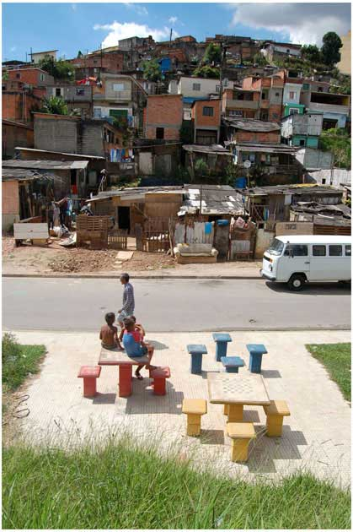
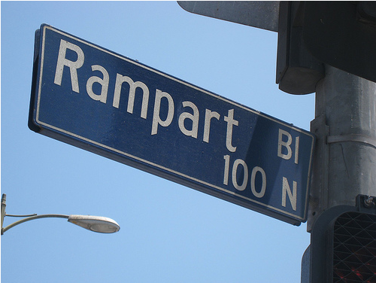
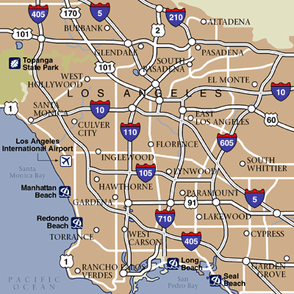
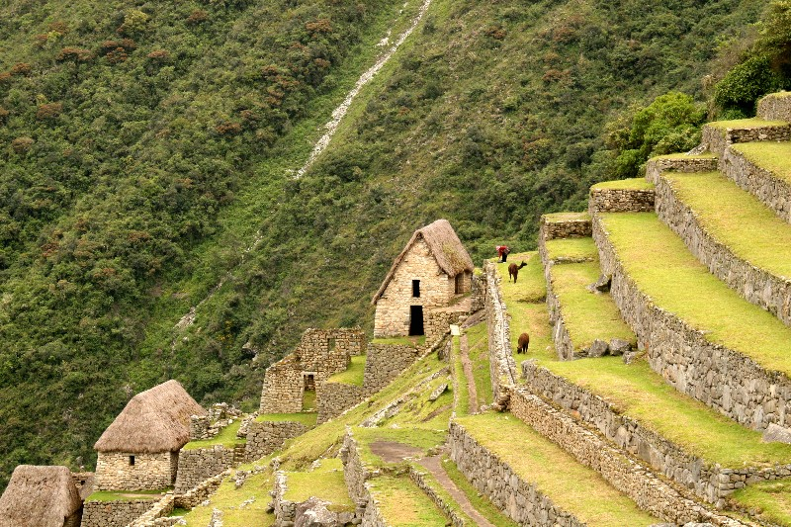
G- Geography Examples

Slide 4
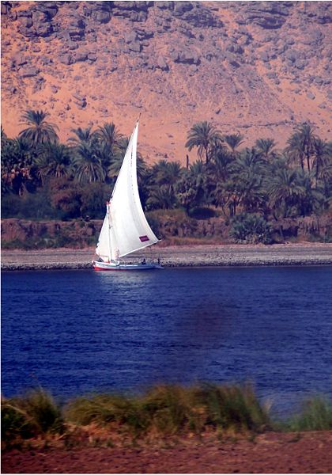
Example: geography
Civilizations began along rivers like the Nile because they provided the water needed for irrigation.

Slide 5
R
Religion
Society’s beliefs about morals and the afterlife.
Rules?
How does Religion affect different part of your lives?
Who/what did they worship?
Rituals?
Holidays?
Holy Books?

Slide 6
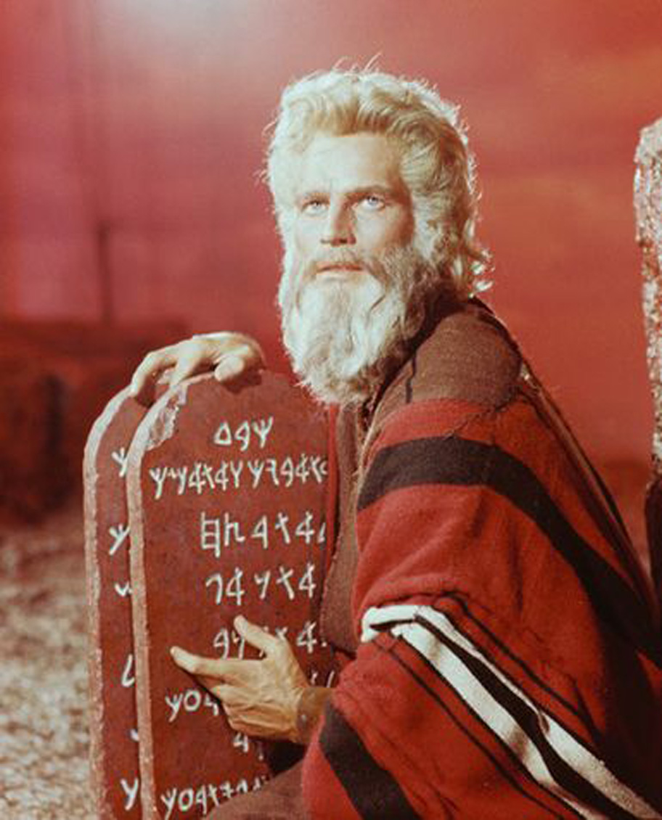
Example: Religion
The Ten Commandments are religious rules that God gave to the ancient Hebrews.

Slide 7
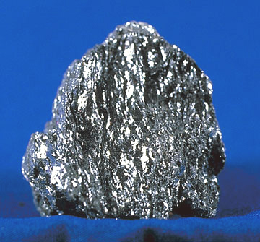
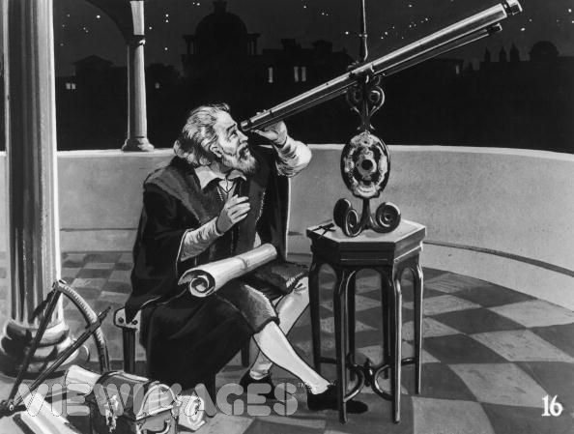
A. - Achievements
Achievements are important discoveries for future generations to enjoy.
Art, architecture, technology, inventions, and ideas are usually the achievements we enjoy and try to improve.
All civilizations are measured by their achievements.
Iron Ore
Trephination
The Telescope

Slide 8
Achievements
A
The lasting works of a society.
What did they build?
What did they invent?
How did they improve technology?
Which ideas, if any, still affect our lives today?
What can other cultures learn from this culture?

Slide 9
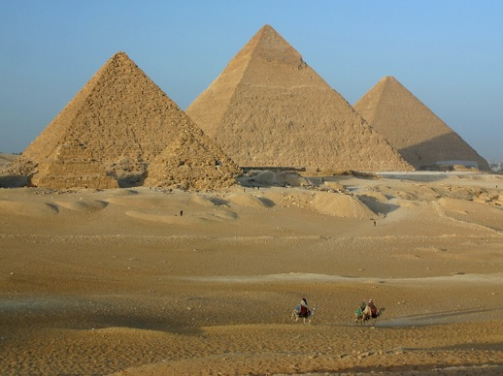
Example: achievements
Millions of people still visit the pyramids in Egypt every year.
Notes:
‹#›

Slide 10
Political system
P
Who runs a society, and how do they do it?
How does someone come into power?
Who has power, and how is it used?
How do those with power keep it or lose it?
Type of government?
Patterns of warfare?
Laws
Punishments/Consequences
Notes:
‹#›

Slide 11
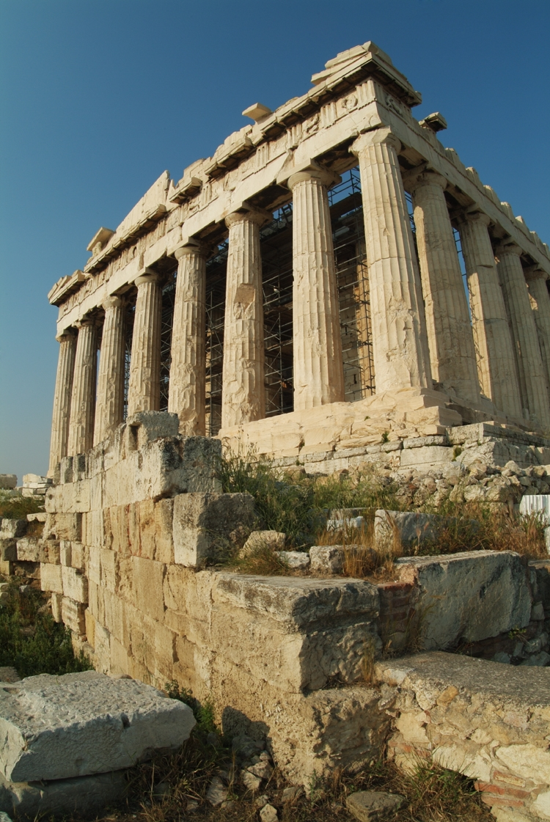
Example: Political system
A limited form of democracy was practiced in Athens.
Notes:
‹#›

Slide 12
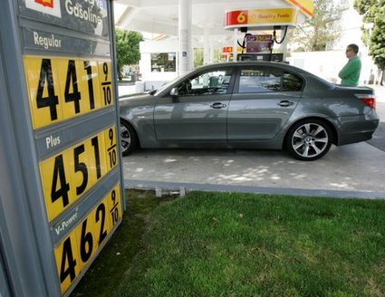
E
Economics
How a society uses its scarce resources.
Do they trade or sell?
What do they trade or sell?
Do they use money?
What are the trade routes?
Do they have taxes?
How do they use their taxes?
Does their economy help ALL of the community?
Notes:
‹#›

Slide 13
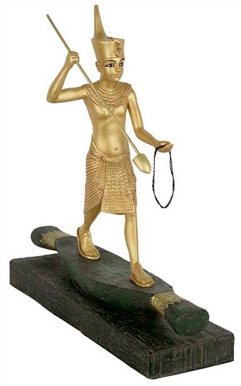
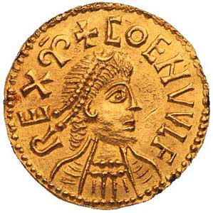
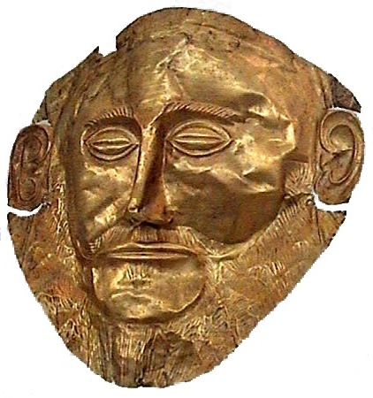
Example: economics
Gold has been a valuable resource in many civilizations for thousands of years.
Notes:
‹#›

Slide 14
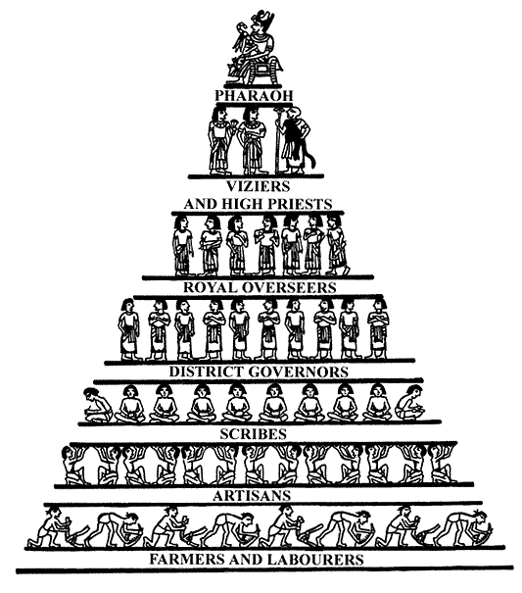
Social structure
S
The different levels or classes in a society.
Who are the “most important” people in society? What do they do?
Who’s at the bottom?
What privileges were given to each class?
Recreation- What did they do for fun?
Music?
Art?
Notes:
‹#›

Slide 15
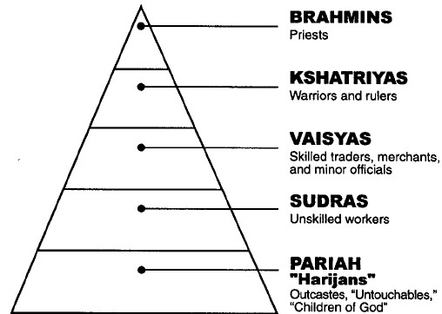
Example: social structure
Indian society was divided into a rigid caste system.
Notes:
‹#›

